Slide 1
Ace Info Solutions, Inc. Centers of Excellence (CoE)
Collaborate | Innovate | Integrate
11490 Commerce Park Drive, Suite 340
Reston, VA 20191 | Office: (703) 391-2800 Fax: (703) 391-2833 | aceinfosolutions.com

Slide 2
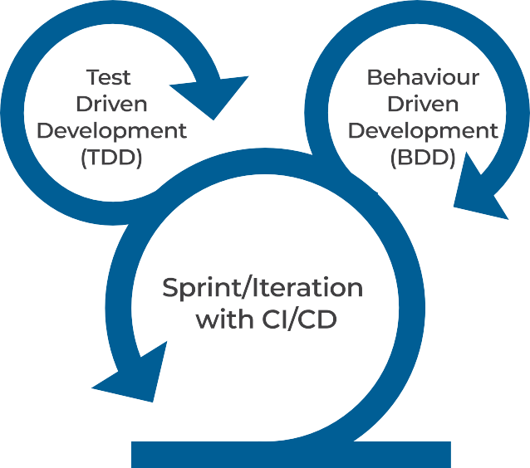






















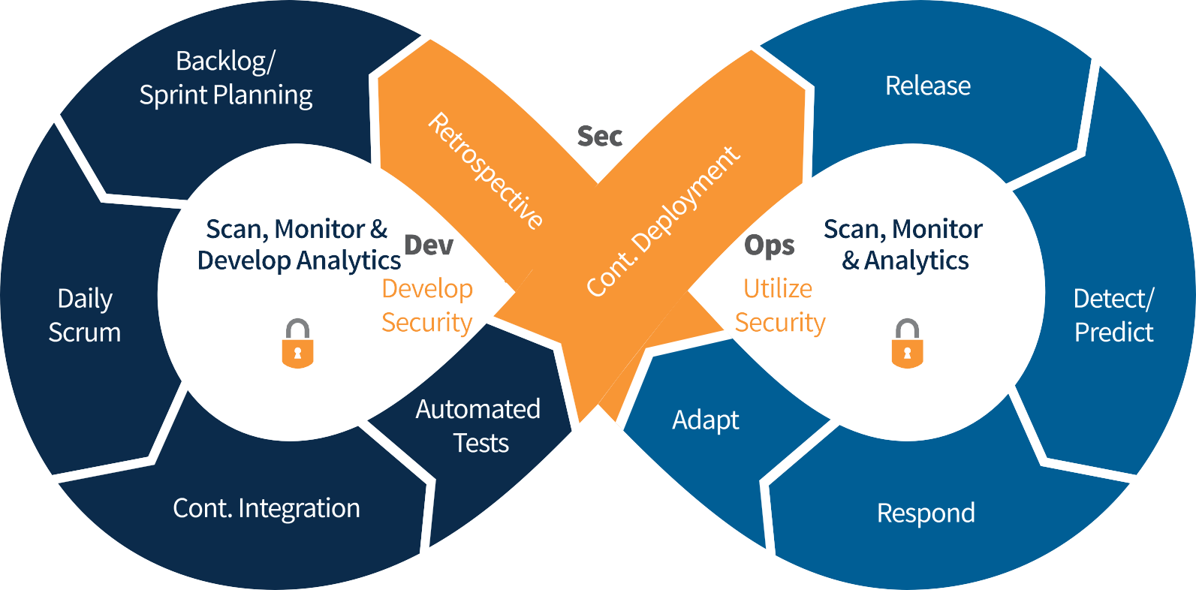
DevSecOps & Agile
DevSecOps methodology ensures that the Operations and Security teams are continuously engaged with Development teams from the very beginning while focusing on Automation, Continuous Integration, Continuous Delivery, Continuous Deployment of smaller increments of a working product.
DevSecOps with Agile practices enables the teams to prioritize the work fed into DevSecOps continuous release cycles, enhance team communication & collaboration by providing thorough visibility and transparency of the entire delivery cycle.
Using DevSecOps teams can rapidly deliver Application, Infrastructure as Code (IaC) and Security as Code (SaC) through automation and use continuous integration and continuous delivery (CI/CD) and release software quickly.
  Improve delivery of projects
  Better manage outages & compliance
  Limit work-in-progress (WIP)

Slide 3
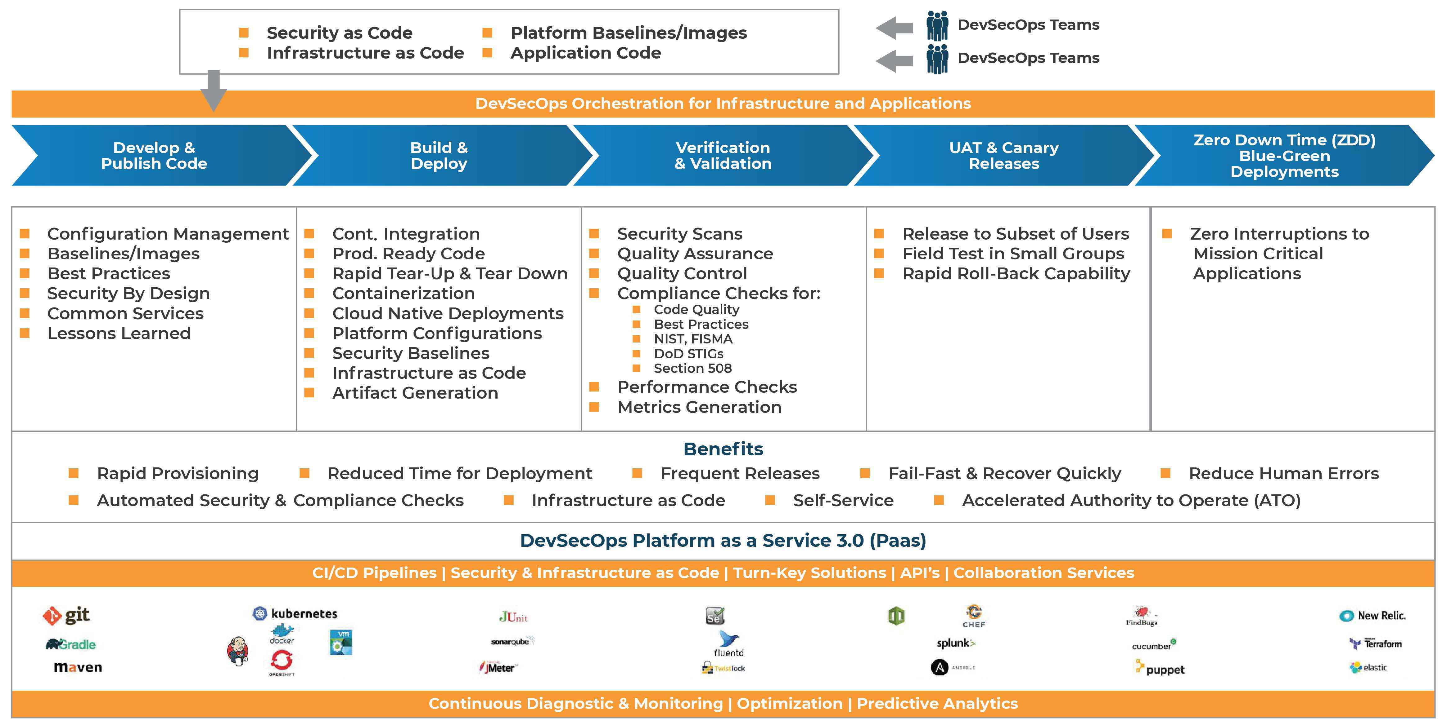
DevSecOps CI/CD Orchestration

Slide 4




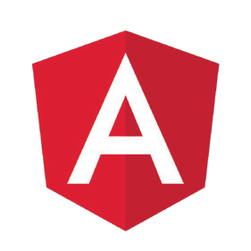

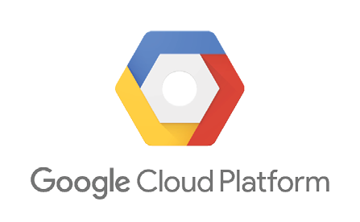

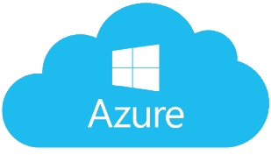
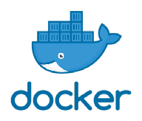
Cloud Native Application Architecture
DevOps & Cloud Enabled
Tier 1 / Tier 2
Browser
External Integration
Security
Data Exchanges
Cloud Enabled
Data Layer
Presentation Layer
RDBMS:
MySQL, PostgreSQL, Oracle, MSSql Server
Application Layer
User Centric, Responsive UX / UI
NoSQL:
MongoDB, Dynamo
Data Persistence Layer
Middleware Layer
Services / API Layer
Decomposition | Micro Services | Containerization

Slide 5
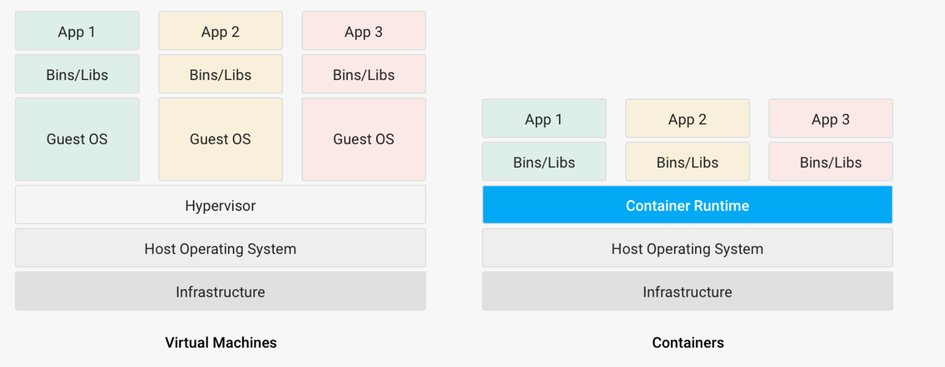
Containers What are they?
Containers are small portable logical packages of application and all its runtime dependencies — such as libraries, servers, and system resources into a well-defined, portable artifact object that can be packaged once and deployed anywhere and across multiple platforms.

Slide 6
Containers Why do we need them?
Complexity: Developing and deploying cloud native applications rapidly and at scale and across multiple environments as well as into Private, Public and Hybrid clouds is complex, — even more so when web, cloud-ready, and mobile applications are built from highly distributed microservices.
Solution: To address this complexity “Containers” have emerged as a solution.
Containerization provides a clean separation of concerns, as developers focus on their application logic and dependencies, while security and operations teams can focus on hardening, deployment and management without bothering with application details such as specific software versions and configurations specific to the app.
Containers combine the potential for rapid delivery with the flexibility to define the details of the underlying platform, from the development language to the operating system.
Containers also provide a common framework and language that tie development, operations, security, quality assurance (QA), and other teams together. Together, they can use containers to build and deploy infrastructure and applications at a cadence that meets business needs.
Rapid build-up and tear-down with minimal cost.
Built for end-end automation.
Built to scale
Support Zero Downtime Deployments

Slide 7
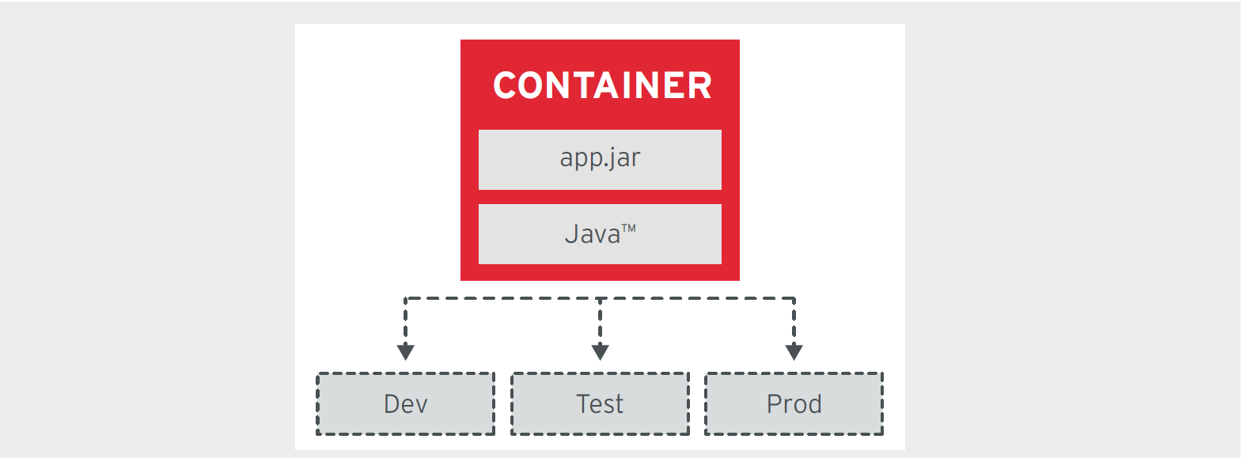
Containers Benefits - Immutability

Slide 8
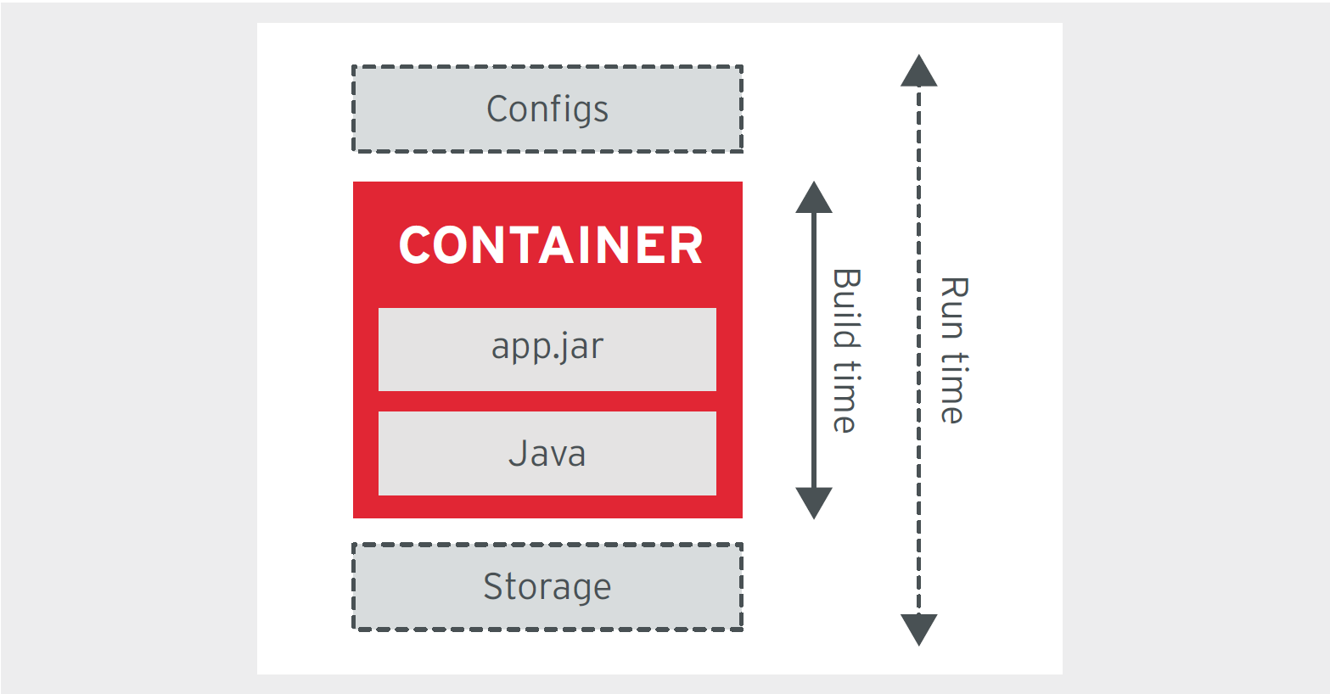
Containers Benefits – Self Containment

Slide 9
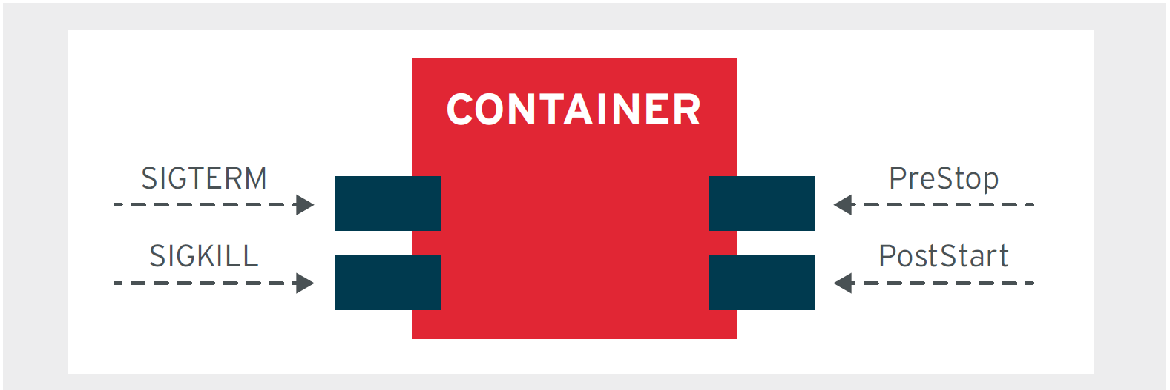
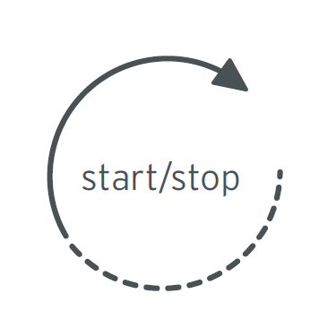
Containers Benefits – Life Cycle Management

Slide 10
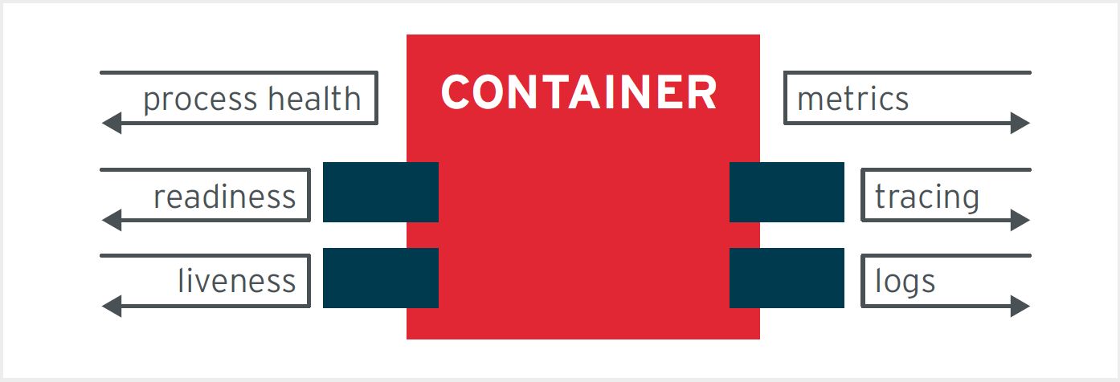
Containers Benefits - Observability

Slide 11
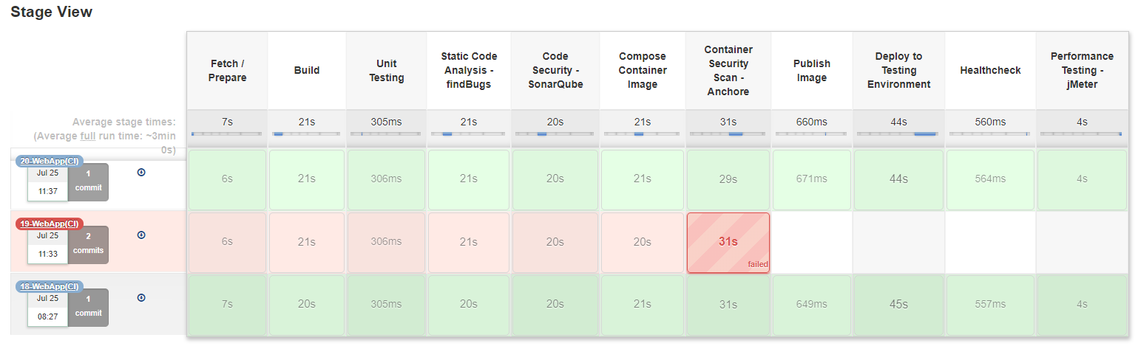
Containers example
Sample Docker File Content
    FROM openjdk:8-jre-alpine
    VOLUME /tmp
    RUN sh -c 'apk update'
    RUN sh -c 'apk upgrade’
    ADD myapplication-1.0.0.jar app.jar
    RUN sh -c 'touch /app.jar'
    ENV JAVA_OPTS=""
    ENTRYPOINT [ "sh", "-c", "java $JAVA_OPTS -Djava.security.egd=file:/dev/./urandom -jar /app.jar" ]
CI Pipeline Example

Slide 12
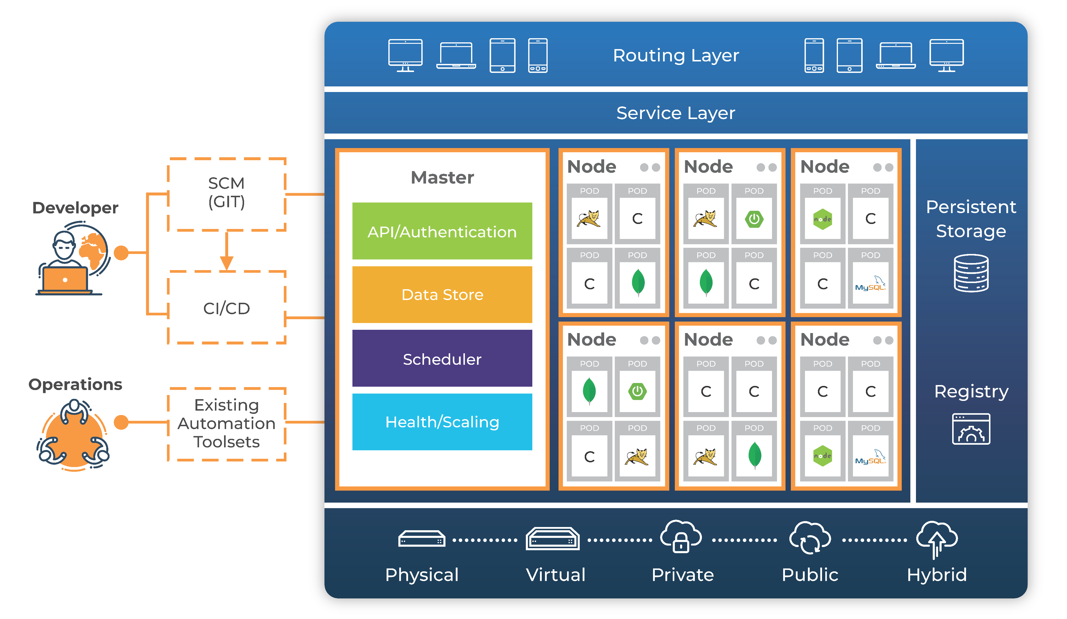
Containers A peek at container orchestration platform

Slide 13
Containers What do I need to start using them?
To start with a simple application that is not a Monolith and built using modern day frameworks (Microservices/API) (later extended to more complex apps)
Application configurations as environment parameters
A hosted container repository
  Nexus (Opensource)
  Docker Hub
A container orchestration platform with configured networking, storage, routing.
  Docker Swarm (Opensource)
  Kubernetes (Opensource)
  Red Hat Openshift (Licensed)
A CI/CD pipeline with stage gates for build, security scan, containerize and deliver the containers.

Slide 14
Containers Where are we doing it?
On Premise - Kubernetes, Docker, OpenShift
  DHS FEMA : 350 - 500 Containers
  U.S. Air Force : 100+ Containers
  USDA : 100+ Containers
  CoE Lab : 30 Containers
Cloud Enabled AWS (ECS & EKS), Google Cloud Platform (GKE)
  CoE Lab : 20 Containers

Slide 15
Containers
Thank You !!

